Slide 1
Operating Systems
The File Management Sub-system
Module CSN08101
Systems and Services
School of Computing Napier University

Slide 2
Learning Outcomes
➘ This handout is intended to help you to:
➘ Understand the structure and functions of a
File Management sub-system.
➘ Understand and appraise mapping of logical
file systems to physical storage.
➘ Extend your knowledge of disk storage
hardware.
➘ Understand how common operating systems
store information on disk.

Slide 3
File Management Functions -1
➘ Users perceive “data” in some application-oriented structure of files and folders (or
directories).
➘ Associated with those structures are functional requirements
➘ Operations for reading, writing, copying, controlling access etc.
➘ These logical structures and their operations do not distinguish between different
types of physical storage media (except for obvious restrictions e.g. CD-ROMs are
read-only).
➘ The physical storage system includes devices and their media, such as:
➘ Magnetic disk storage (e.g. hard disk & floppy disk)
➘ Optical and Magneto-optical devices (e.g. CD, CDW, CDRW, DVD, Minidisk).
➘ Magnetic tape devices (e.g. DAT, Ditto etc)
➘ Semiconductor devices (memory sticks, flash cards etc)
➘ The user’s view of a file must be the same - regardless of the medium
➘ Create a Word document on a hard disk, copy it to a CD, then to a floppy disk.
➘ The logical file must remain the same,
➘ All three physical media use different technology to store and retrieve information,
and the physical representation of the file on the media are different.

Slide 4
File Management Functions -2
➘ The operations are made available to the user and the system by the file manager
➘ Referencing (reading or writing) files and their contents using symbolic names:
➘ Data can be accessed through a symbolic view of the file store, i.e. through
trees of folders (directories) and files, then records with names specified by the
user.
➘ Mapping from symbolic to physical names performed by File manager.
➘ Files may be moved around on the disk surface to optimise performance without any
changes to applications (except location details like drive letters):
➘ The user’s perception of a group of folders or files in “Explorer” does not change if
the group is moved from a floppy to a hard drive, or if a drive is defragmented.
➘ The physical layout on the disks may change entirely.
➘ Creating and deleting files and directories.
➘ Organising user accounts and home directories.
➘ Controlling access according to privileges specified.
➘ Managing the flow of data between the processor and the disk units to ensure integrity
of data on disk and correct interpretation of mappings.
➘ “Simultaneous” requests for data from different applications don’t get mixed up.
➘ Throughput of data between disk and processor is maximised.

Slide 5
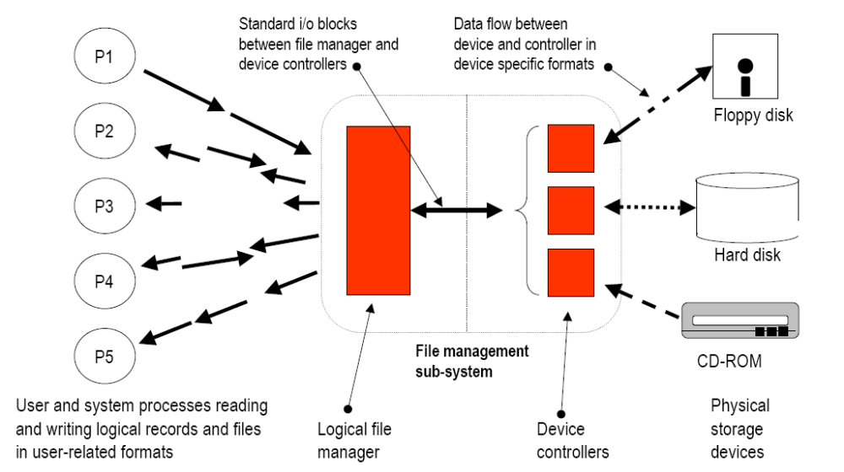
Mapping of user data to devices

Slide 6
Logical file and record formats
➘ Logical files and records
➘ Users work in terms of folders and files with specific purposes.
➘ Reports in “Word” documents, spreadsheets in Excel format,
pictures in “jpeg” format, programs in “exe” files.
➘ These files are organised in a hierarchy of folders or
directories.
➘ The hierarchy has significance to the application or the user.
➘ Users want:
➘ to create, delete and move folders.
➘ to run programs contained in the folders.
➘ to manage or manipulate the data contained in files
➘ Ideally, the layout of folders and files, and the operations allowed
should be intuitively understandable to users who know about the
domain of the application.

Slide 7
Physical storage formats
➘ Physical storage media
➘ Each type of device is based on a technology which supports specific
structures and operations.
➘ A floppy disk is similar in concept to a hard disk and is based on the same
principles.
➘ A CD-ROM stores data, and reads data completely differently.
➘ A memory stick is totally different from both of the above.
➘ Each type of device has a “device controller” which is designed to deal with
the operation of the device, and the type of data it holds.
➘ The device controller converts between the format of the data used by the
device hardware, and internal format(s) used by the file management
subsystem.
➘ The file management sub-system converts between user or applicationoriented
file and record formats, and interacts with the relevant device managers to store or
retrieve data.

Slide 8
File Management Functions -3
➘ An interface is defined between the logical file manager and the device controllers
➘ This interface implements a model which is then “imposed” on all storage
devices.
➘ The interface supports standard i/o blocks each of which is identified by a
logical block number
➘ The logical blocks are distributed across the storage medium (e.g. across the
surface of a disk).
➘ Initially the blocks are unallocated in a “pool” or a list owned by the file
manager.
➘ When a file is “saved” it will occupy a number of these logical blocks.
➘ As a file is extended, it will be allocated additional blocks
➘ When a file is deleted, its blocks will be returned to the file manager’s pool.
➘ The relationship between a logical file, and the blocks it occupies is maintained by
the file manager.
➘ Individual device controllers convert between the block model and the actual
storage technology used by the device.

Slide 9
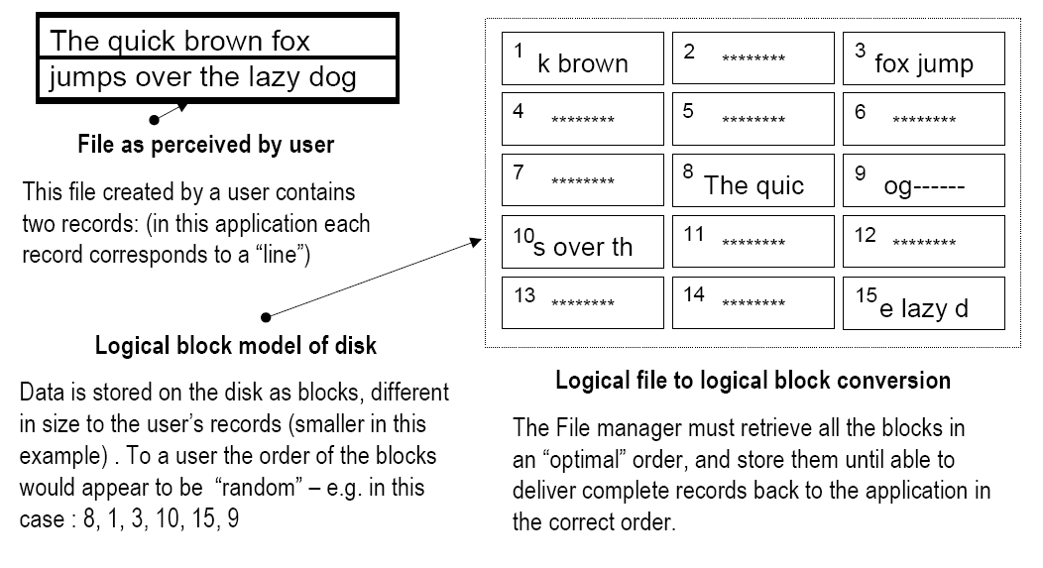
File Management Functions -4

Slide 10
File Management Functions -5
➘ Consider an application reading a file:
➘ The “read” instruction causes a system call (a type of interrupt). The application blocks,
and the interrupt is serviced by the Interrupt controller, which stores details of the
request in a data structure. A scheduling flag is set for the File Manager.
➘ Eventually the File Manager will be selected by the scheduler. It locates the file entry in
the file index (the directory) and identifies which blocks are needed. It then translates
the request into the low-level instructions needed by the disk device controller and
issues these. The File Manager process then returns control to the scheduler.
➘ The device disk controller retrieves the data form the disk and stores the blocks in a
buffer area. It marks the request as done, and signals “I/O complete for the File
Manager. The interrupt causes the scheduler flag for the File Manager to be set.
➘ When the File Manager runs, the blocks are retrieved from the buffers and assembled
into the logical records needed by the application. When done, the File Manager signals
“I/O complete for the application, which causes the scheduler flag for the application to
be set and the blocked process becomes “ready-to-run” .
➘ The application will eventually be scheduled, and will start from the instruction
immediately after the “read”. The logical records will be available to the process.
➘ In some systems these signals and requests are called “events” and are managed by an
intermediary called the Event manager - another OS subsystem.

Slide 11
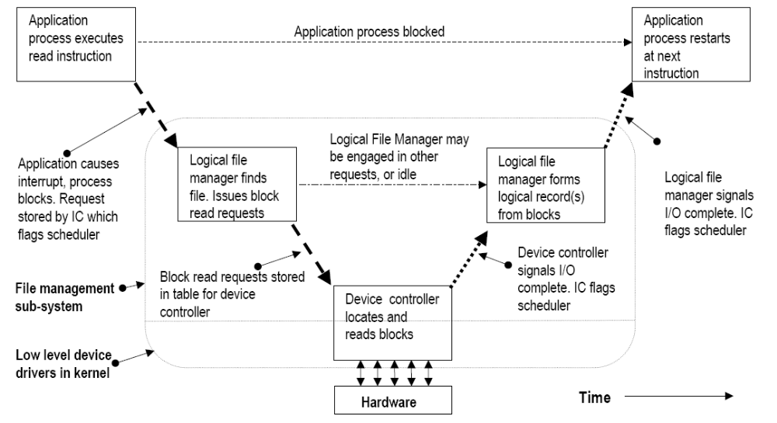
File Management Functions –5b

Slide 12
Structure of the File manager - 1
➘ The File manager accepts requests from users requiring access to the file system.
➘ It creates files by creating the directory entries.
➘ It writes data to files by obtaining blocks from a “free pool”, packing logical record
content into blocks, following the indexing structures to find the correct location for the
blocks and writing them into those locations.
➘ It extends files by allocating additional disk blocks updating the index structures and
storing the additional data as described above.
➘ It contracts or deletes files by altering/removing directory entries and returning disk
blocks to the “free pool” (usually a dummy file that owns all free blocks).
➘ It reads data from files by following the indexing structures to find the required blocks
and constructing the logical records from the blocks.
➘ The File manager is layered like most areas of the OS:
➘ The highest layer supports user-level abstractions - files of different types, some with a
logical record structure, and folders (directories) inside which the files are orgainised.
➘ The intermediate layer(s) accept requests from the top layer and organises them to
achieve best performance from the lower layers, then reassembles the results.
➘ The lowest layer “talks” directly to the specific hardware controllers for the individual
storage devices. Parts of this layer are usually in the kernel.

Slide 13
Structure of the File manager - 2
➘ Consider an application which is required to read all of the logical records
stored in a disk file.
➘ This kind of requirement would result if we read all of the “employee”
records from a “personnel” file.
➘ The logical order of the records could be “alphabetic by employee surname”,
or “employee number”.
➘ A logical record may be larger, or smaller, than each blocks depending on
the application, and the hardware of the disk.
➘ The physical blocks containing the records will be stored in various locations
in different parts of the disk surface.
➘ The device controller will attempt to retrieve the blocks in the most economical
way (least work for the disk mechanism). This may be random from the point
of view of a logical record.
➘ Blocks have to be stored (buffered) until the logical record can be
reconstructed. Logical records may have to be buffered until they can be
delivered to the application in the right order.

Slide 14
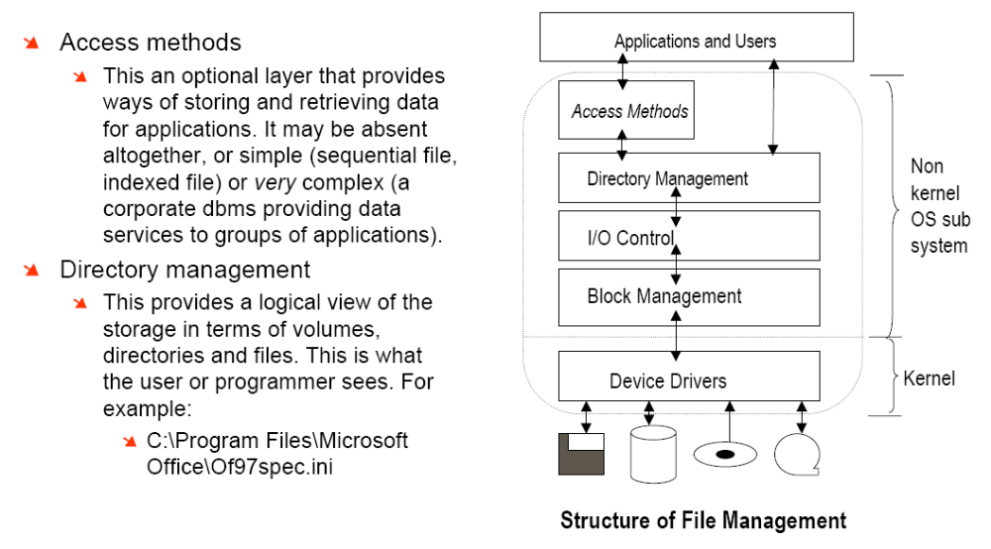
Structure of the File manager - 3

Slide 15
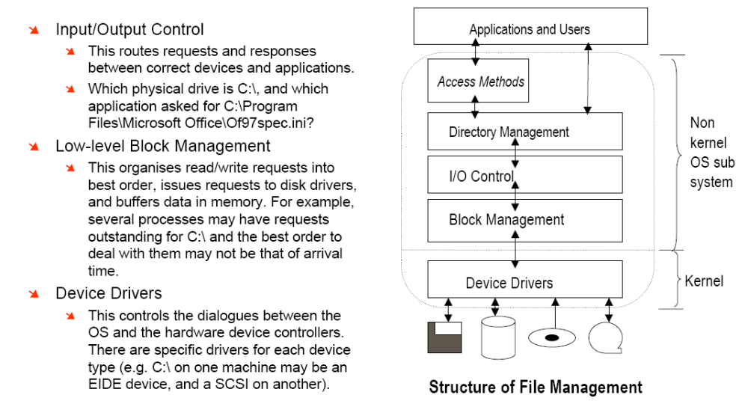
Structure of the File manager - 3

Slide 16
Data Storage -1
➘ The physical media such as hard disks, floppy disks, CD-ROMs, DVDs and tapes
store information as magnetic or optical “marks” on a physical surface.
➘ These marks are not recognisable as programs or data - simply as encoded bits
➘ The encoding methods are often complex.
➘ Groups of marks (called blocks) can be read or written by “heads”.
➘ Blocks are the units of transfer between the hardware and the OS.
➘ The head(s) can be positioned to read or write specific blocks.
➘ On magnetic disks (e.g. hard disks and floppy disks) the blocks are stored in
concentric rings called tracks. Each block is addressed by the track number and
the “sector” - i.e. how far round the track a particular block lies.
➘ On optical disks, the blocks are written in a continuous spiral containing the
blocks - they were originally designed for music using mainly serial access.
➘ The blocks making up a file will be stored anywhere on the medium.
➘ This is particularly true with magnetic disks after being in use for some time.
➘ Files are created, extended, compacted and deleted - new files fill gaps etc.
➘ Other device types such as memory sticks use other technologies

Slide 17
Data Storage -2
➘ Magnetic Disk Controller
➘ This is the hardware which connects the kernel device driver for the magnetic disk(s) to
the disk hardware. On a PC, it is normally a chip located the motherboard.
➘ Different types exist (SCSI - small computer systems interface, (E-IDE - Enhanced
Integrated Drive Electronics)
➘ It manages the flow of data between the processor and the disk units.
➘ Disk units may be on a shared bus, or on individual buses.
➘ A “channel” is a small processor which controls a single disk unit.
➘ Magnetic Disk Unit
➘ Contains a set of circular platters rotating at high speed (normally over 5,000+ rpm), on
a common spindle. The platters have a magnetic coating on the surfaces.
➘ Read/write heads mounted on fingers move radially across the platters, just above the
surfaces. Each head “sees” the surface as concentric tracks.
➘ A “cylinder” is a set of tracks directly above/below each other, and a “sector” is an
angular “wedge” of the surface. A sector is usually a hardware block.
➘ Blocks are numbered with a logical block number (LBN), and located by their CHS
address (Cylinder, Head, Sector)
➘ Reference points are set up during formatting of the disk, so that the location of block x
at cylinder p, head q, and sector s can be determined.

Slide 18
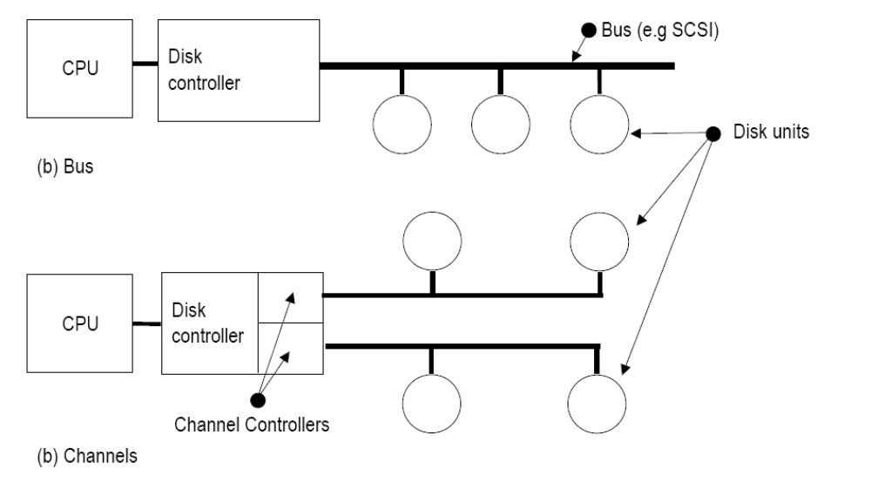
Organising disk hardware

Slide 19
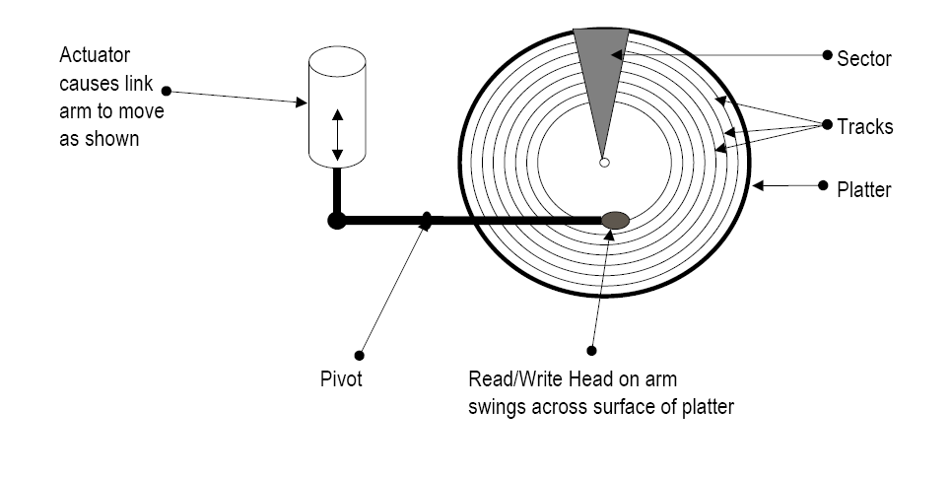
Data Storage -3

Slide 20
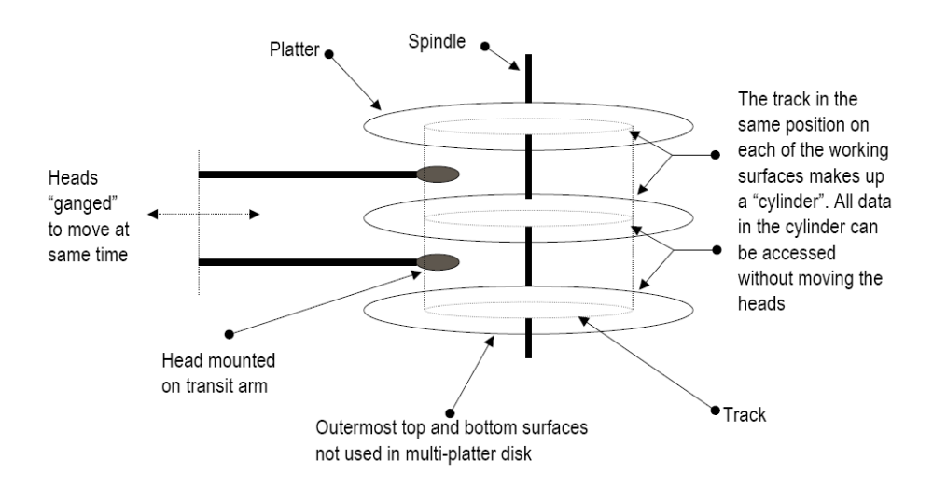
Data Storage -4

Slide 21
The Physical Disk-1
➘ The disk hardware needs to be able to move the disk head(s) across the platter(s)
from track to track to locate any physical sector to read or write data blocks.
➘ The “Access Time” is made up of the “seek time” plus the “rotational latency”.
➘ The seek time the time needed to move the head from one track to another:
➘ It comprises: a starting delay to accelerate the head, steady movement across tracks, and
a stopping delay. A change of direction from the previous seek also increases the total
time. The time to move across the tracks depends linearly on the number of tracks
traversed – to traverse ten tracks takes ten times longer than one track.
➘ Rotational latency is the time spent waiting above the track for the correct sector to
arrive under the read/write heads - on average this will be one-half the rotational
time. (The best case is zero, and the worst case is one full revolution)
➘ The total access time is the sum of both - typically an average of between 8-15 mSec
on a modern hard disk, rotating at between 3,600 and 7,200 rpm.
➘ The data transfer rate (KBytes/sec) is another factor in disk performance
➘ It depends on the individual disk unit and the controller type.
➘ SCSI disks are generally faster than EIDE disks.
➘ One main reason is that the SCSI controller is multi-threaded, the EIDE controller is
not, so requests can be part completed without giving up the processor.

Slide 22
The Physical Disk-2
➘ Consecutive read/write requests may refer to totally disjoint locations.
➘ Disks employ seek algorithms to decide the order in which to visit different locations on
the disk to service requests
➘ The choice of algorithm has much more effect on performance than small changes in
total seek-time.
➘ Aim of more efficient algorithms is to minimise head movement, so saving time overall.
➘ First Come First Served (FCFS)
➘ All requests are dealt with strictly in the order of arrival. A simple First-in, First-out queue
is used to store requests. Results sent back to processor immediately. Simple to
implement, no buffering required, but potentially very slow.
➘ Shortest Seek Next (SSN)
➘ Requests are queued and carried out so that the request causing the shortest seek
movement is always done next.
➘ Improves efficiency by servicing “shortest” requests first.
➘ In a heavily-loaded system the tendency is for heads to remain near middle of disk and
for requests at the peripheries to be queued indefinitely.

Slide 23
The Physical Disk-3
➘ Elevator algorithm
➘ Requests are put into a queue as they arrive.
➘ A bit is set to note the direction the head was moving in when dealing with the
previous request.
➘ The next closest seek in the same direction of travel is taken from the queue.
➘ When there are no more requests in that direction, the direction is reversed.
➘ Disk head tends to move steadily across the disk in alternate directions.
➘ These methods may deliver data in different order from that expected by
applications:
➘ Individual applications to wait for data.
➘ Requests and data will need to be buffered in the block manager layer.
➘ Address translation in the BIOS between CHS and LBN
➘ Disk hardware uses Cylinder Head Sector (CHS) address to locate data block.
➘ Logical File Managers use Logical Block Number (LBN).
➘ Translation of CHS to LBN is usually done in the BIOS, using a table or a formula
created when the disk unit is installed.

Slide 24
File to disk-block mapping methods
➘ Two different approaches - FAT (File Allocation Table) and I-node (Index Node)
will be considered to illustrate techniques and implications
➘ File Allocation Table (FAT)
➘ A FAT is a table that has an entry for every block of data on the disk.
➘ FATs were first used for floppies in CP/M, then its successor MS-DOS.
➘ The method was extended to Windows-95, 98 and ME
➘ Windows NT (including 2000 and XP) has its own method (NTFS) but all versions can
access FAT file stores (all floppy disks use the FAT method).
➘ inodes (or index nodes)
➘ An inode is an index table that relates to a single file and shows which blocks are
being used by that file.
➘ inodes can be daisy-chained to provide access to very large files.
➘ That is, an inode for a file can point to further inodes, which in turn point to the data blocks
of the file.
➘ This approach has been used in many UNIX systems for 30+ years.
➘ Both techniques require a “root” directory to be held at a fixed physical reference
point to allow the logical directory structure to be accessed.

Slide 25
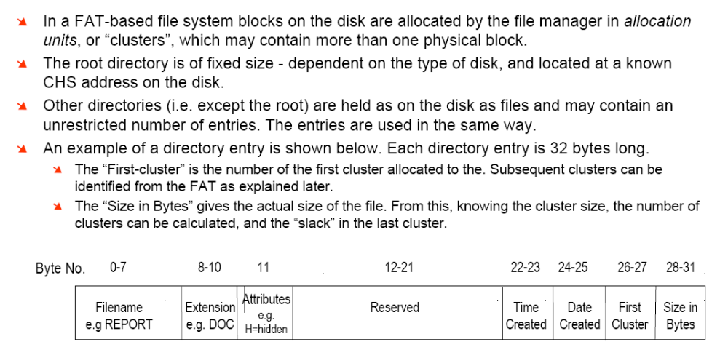
FATs – the directory entries

Slide 26
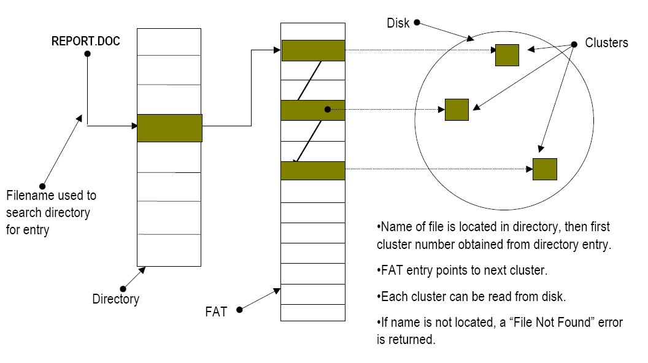
Overview of file access using a FAT

Slide 27
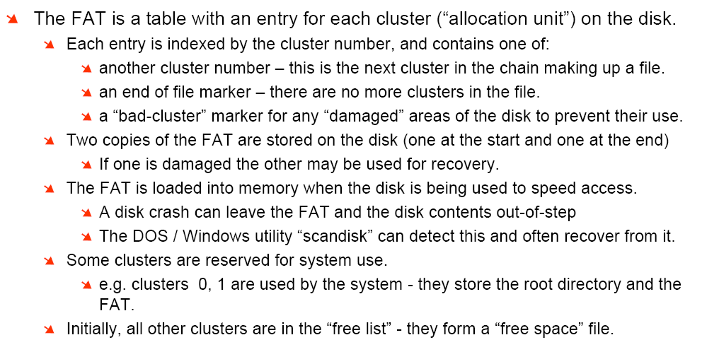
FATs -1

Slide 28
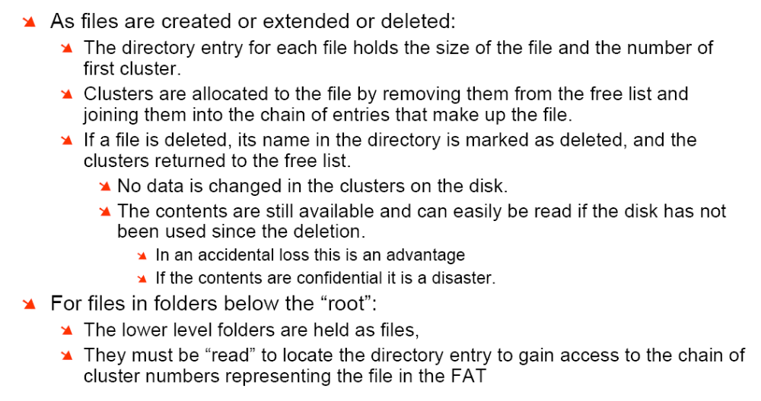
FATs -2

Slide 29
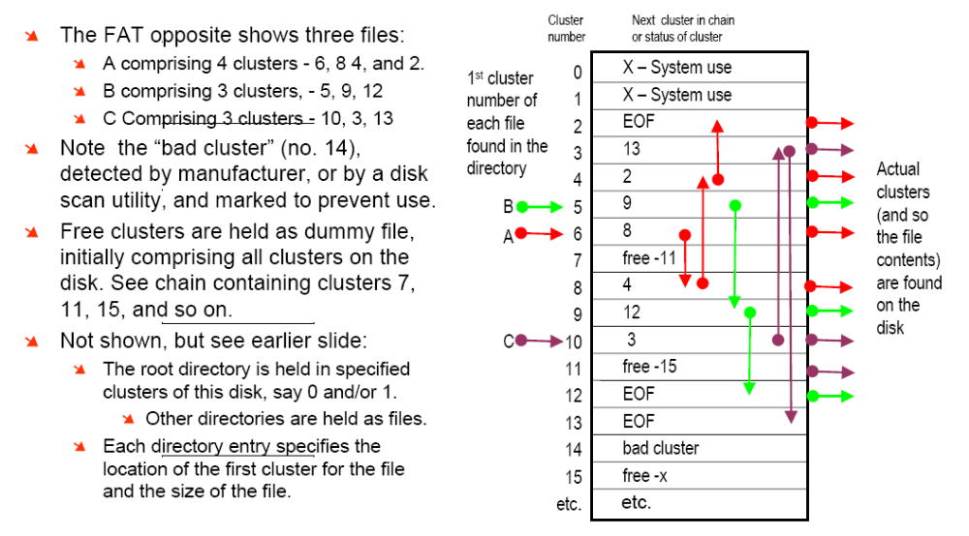
FATs -3

Slide 30
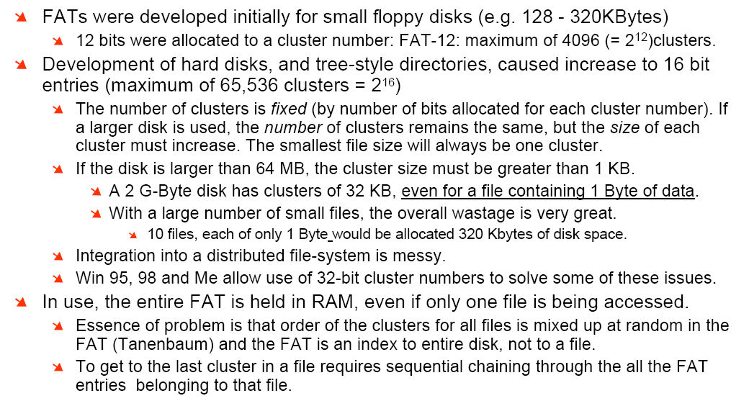
Problems with FATs

Slide 31
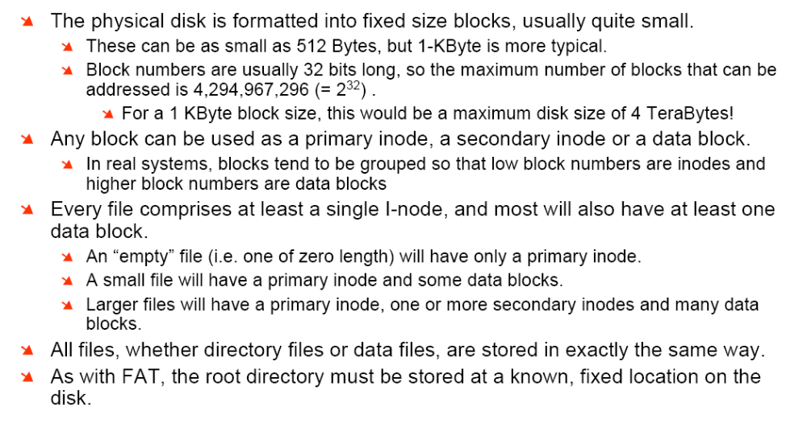
inode file structures -1

Slide 32
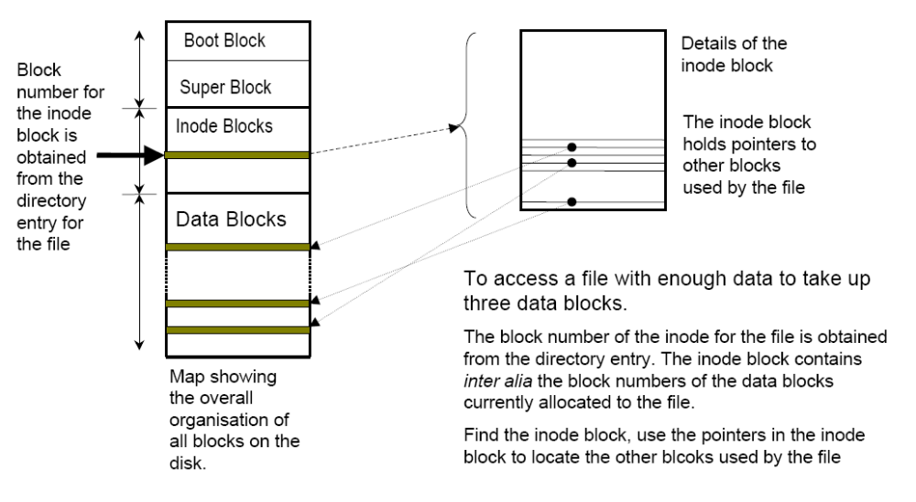
inode file structures -2

Slide 33
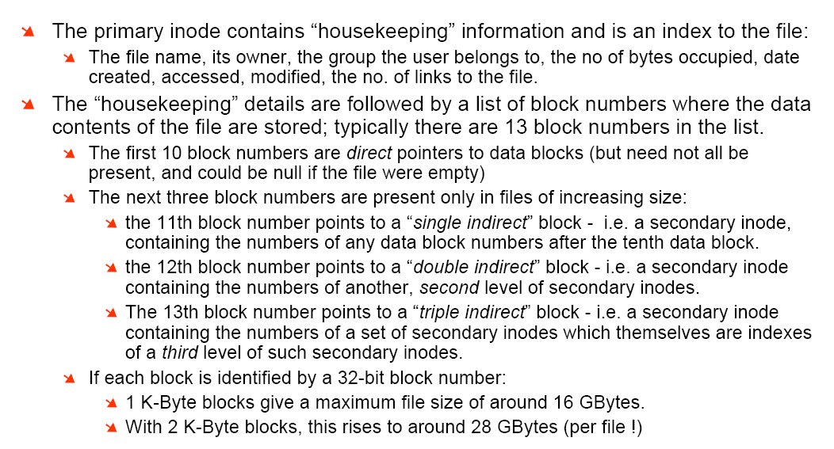
inode file structures -3

Slide 34
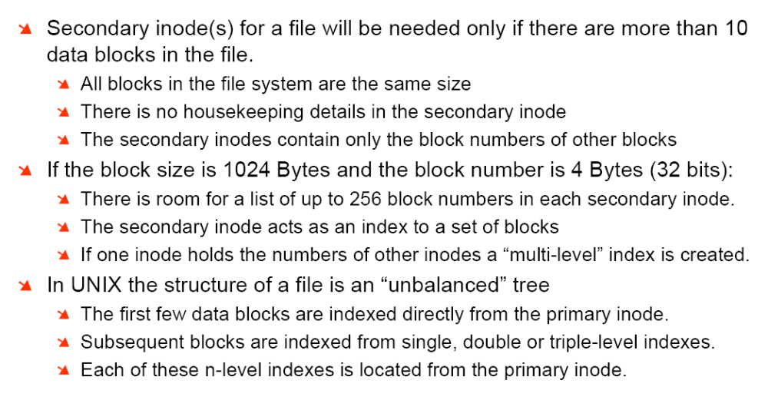
inode file structures -4

Slide 35
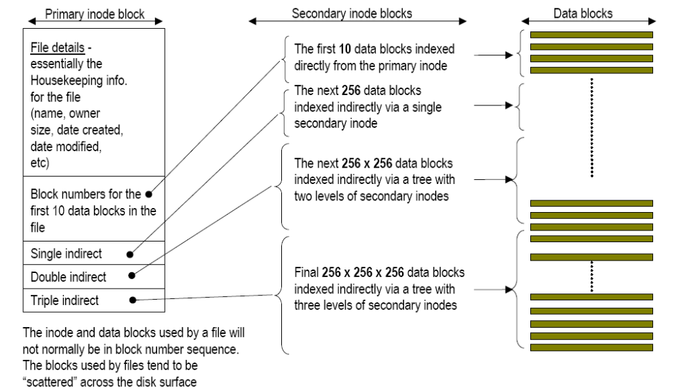
Structure of a file using inodes -1

Slide 36
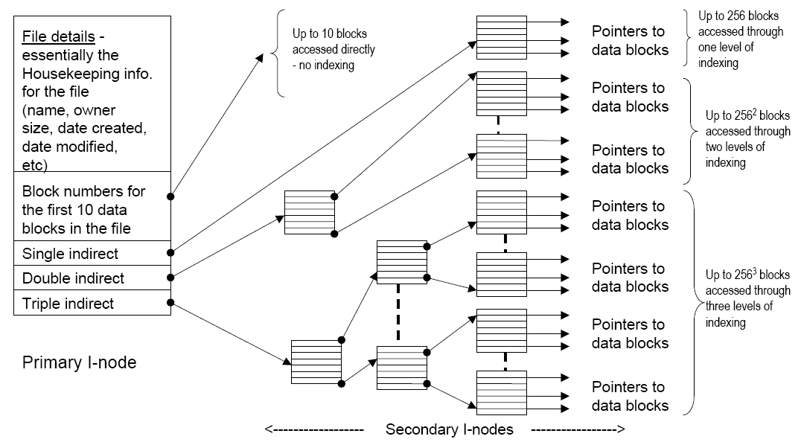
Structure of a file using Inodes-2

Slide 37
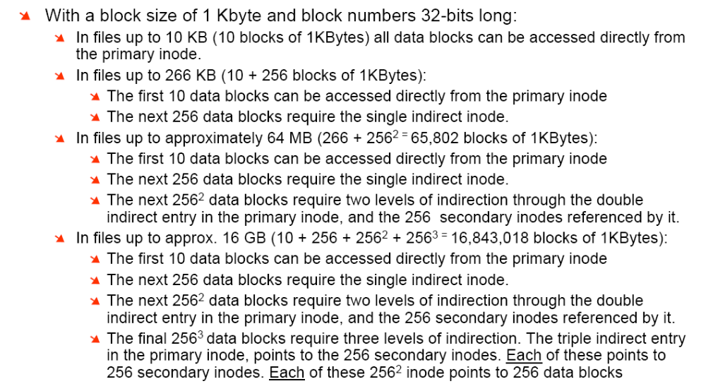
Structure of a file using Inodes -3

Slide 38
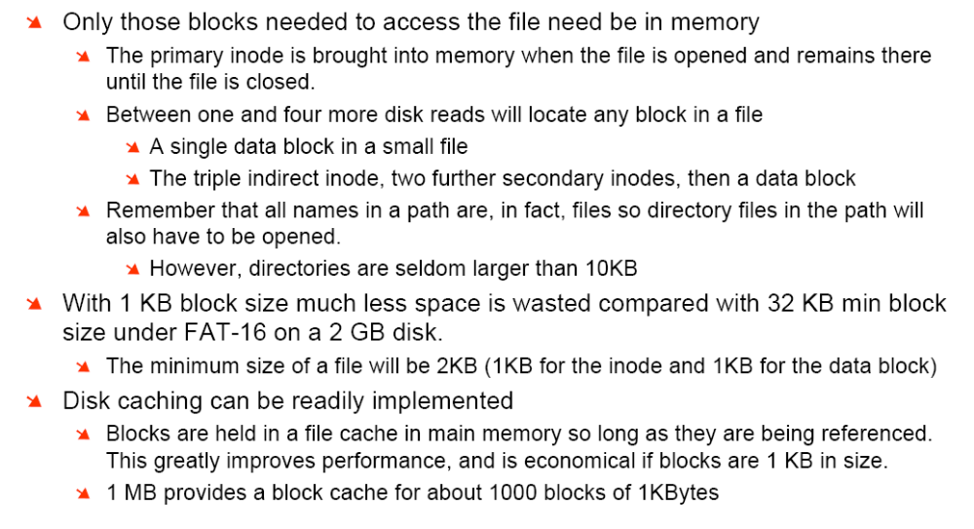
Structure of a file using Inodes -4

